Slide 1
IBMHackChallenge – A Mega Hackathon
Problem Statement 3 : Help me with my mood
Team Name : Brogrammerss

Slide 2
Team Members :
 | Name | Role
1 | Amitabh Tiwari | i) Development of ibm-aggregator and ibm-recommender modules ii) Deployment of Node.js and python servers
2 | Akash Shendge | i) Development of ibm-analyser ii) Dashboard

Slide 3
Technology Stack :
a) Programming Languages : NodeJS with Express Framework, Python
b) Database : MongoDB hosted on MLAB
c) Hosting Servers : IBM Cloud, Heroku
d) Server Type : REST
e) Machine Learning Models Used : LDA and TF-IDF
f) Third Party APIs : Twitter REST API, Medium RSS Feed, Instagram APIs, YouTube APIs, Nearby Places APIs, Google Chart APIs, Algorithmia Models, IBM Custom Model APIs, IBM Watson Language Translator, NLP and Analytics, Tone Analyser, Personality insights etc.

Slide 4
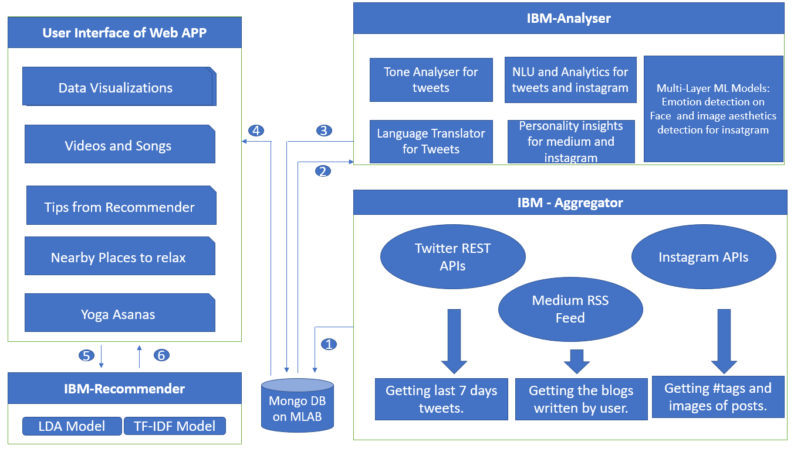
Architecture :

Slide 5
Process Flow :
User provides social media handles.
UI calls ibm-aggregator module to fetch data into database.
UI calls ibm-analyser to analyse the data fetched and update it.
Finally dashboard is populated with charts, tips from recommendation engine, songs and videos from youtube, nearby places like temples and yogas based upon emotion detected.

Slide 6
Key Functionalities of Developed Solution :
Data is fetched not only from Twitter but also from Medium.com and Instagram.
Emotion detection is applied on photos apart from text.
Use of Language Translator module to translate all tweets to English so that other IBM Watson modules can use it effectively.
Graphical representation of data using Google Charts.
Recommendation engine for providing tips based upon emotion detected.

Slide 7
IBM Services :
IBM Watson Modules :
Language Translator
Tone Analyzer
Natural Language Understanding
Personality Insights
Visual Recognition
IBM Cloud Service :
Deployed IBM analyser server written in Node.js

Slide 8
User Interface :
Visual representation of data using Google Chart APIs.
Usage of glyphicons.
Usage of collapse class to show tips effectively.
Usage of Google Maps to show route for various places like temples, natural places, hotels.

Slide 9
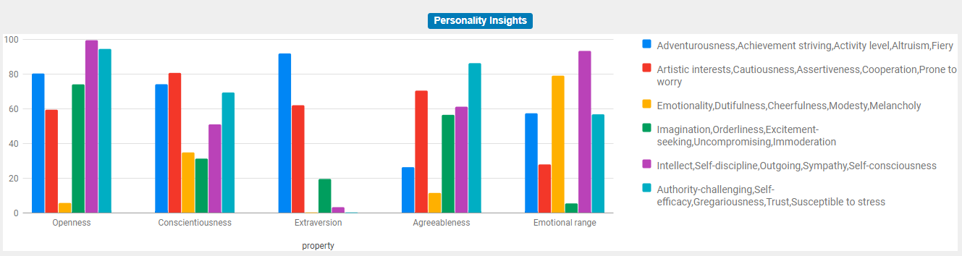
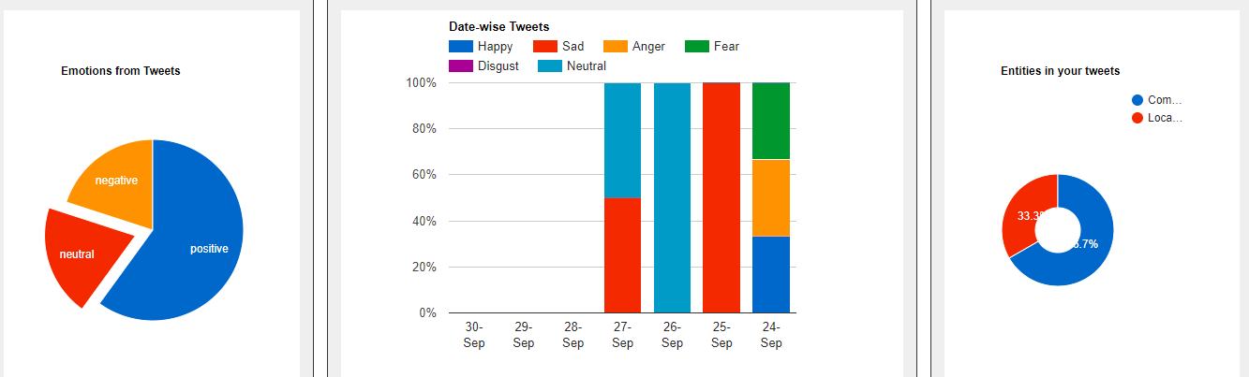
Screenshots :

Slide 10
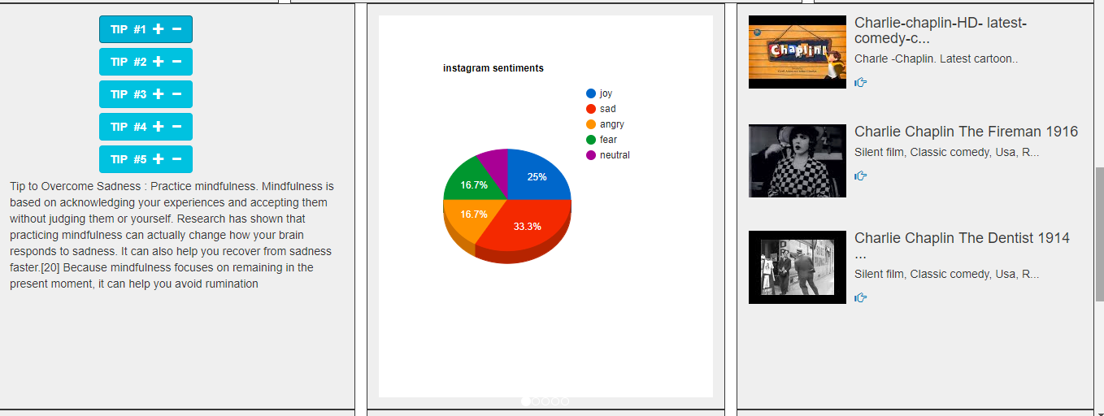
Screenshots :

Slide 11
THANK YOU

